Slide 1

Healthcare Analytics for Doctor Visits TIRTC
Shahina Naaz Khan
Amity University Jharkhand
AICTE STU ID : STU677e95adc89d41736349101

Slide 2


PROBLEM STATEMENT
Resource Allocation Imbalance : Unpredictable outpatient doctor visit volumes.
Demographic Blindspots : Unknown drivers across age, gender and illness.
Core Investigation : Identifying high-risk patient segments to optimize consultation workflows.
Objective: Data-driven clinical capacity planning.

Slide 3
Project Description
This project performs exploratory data analysis (EDA) on a healthcare dataset of 5,190 patient records to understand what drives how frequently patients visit the doctor. The dataset includes 13 attributes covering demographics (age, gender), health indicators (illness score, chronic condition flags), income, and insurance type, with doctor visit count as the key outcome variable.
Data Ingestion : 5190 complete records processed.
EDA & Profiling : Zero null value validation completed.
Clinical Action : Targeted primary care resource planning.

Slide 4

WHO ARE THE END USERS?
Hospital Administrators : Staff scheduling and clinic resource planning
Doctors & Clinicians : Preventive care tracking for chronic cases.
Health Policy Analysts : Subsidy allocation and insurance planning.

Slide 5

Technology Used
  Python 3 : Core Computational runtime.
  Pandas & NumPy : Data wrangling and profiling.
  Matplotlib & Seaborn : Statistical charts and plots.
  Google Colab : Interactive execution notebook.

Slide 6
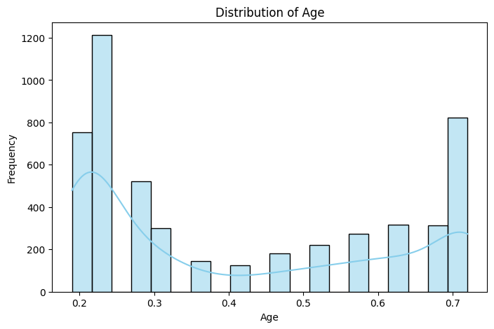
RESULTS
The graph shows the distribution of patient’s
Age that visits doctor. The overlaid density curve on histogram shows that younger age people often visits doctor.

Slide 7
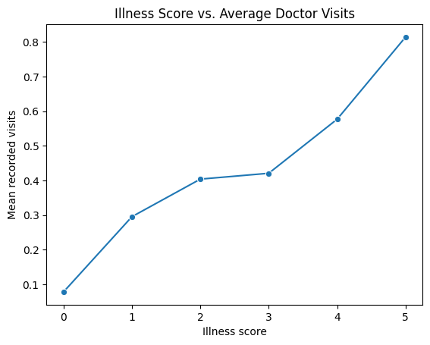
RESULTS
The graph shows Illness score vs doctor visit.
Here, we can see that as the illness score increases
the doctor visits also increases.

Slide 8
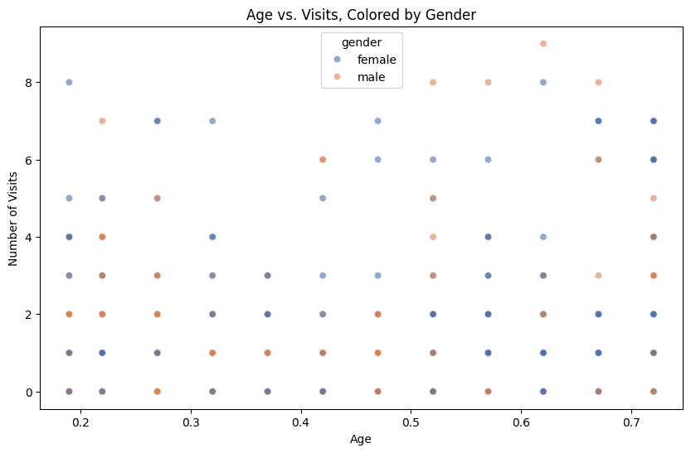
RESULTS
The graph shows a scatter plot of which gender they belong, the age the belong, and the doctor visit they made.

Slide 9
Github Link
https://github.com/Shahina-Naaz-Khan/Healthcare-Analytics-for-Doctor-Visits
.
.

Slide 10
Thank you
.
.

